Slide 1
Improving Birth Outcomes
Diane M. Daldrup
State Director Program & Government Affairs

Slide 2
Agenda
MOD Healthy Babies Are Worth the Wait campaign
Hospital, professional and consumer resources
ASTHO Challenge – what is it and how you can participate
Kansas March of Dimes quality improvement programs

Slide 3
HBWW Campaign
HBWW – preterm birth prevention initiative focused on preventing preventable preterm birth.
Community program with five key components:
  Partnerships & collaborations
  Provider initiatives
  Patient support
  Public engagement
  Performance measures

Slide 4
HBWW Campaign
MOD pilot program launch - 2006, Kentucky Chapter
National launch - 2008 Prematurity Symposium, Wash, DC
Target Focus Areas:
  Eliminate birth disparities
  Eliminate early elective deliveries
  Group prenatal care models
  Preconception care models
  Smoking cessation

Slide 5

Campaign Multi-Tier Approach
Hospitals & Clinics
Health Care Professionals
Consumers
Professional Associations

Slide 6

TIOP III
Towards Improving the Outcome of Pregnancy
Developed through partnership with the March of Dimes, American College of Obstetricians and Gynecologists, the American Medical Association, American Academy of Pediatrics and the American Academy of Family Physicians
TIOP I – 1976
TIOP II – 1990
TIOP III - 2010

Slide 7
TIOP III
Towards Improving the Outcome of Pregnancy
TIOP III – “Enhancing Perinatal Health Through Quality, Safety and Performance Initiatives.”
Areas of focus include:
Developing robust perinatal QI and safety initiatives
Decreasing disparities in perinatal care and outcomes
Developing partnerships between providers and patients for shared decision-making and perinatal care
Standardizing the regionalization of perinatal services
Strengthening the national vital statistics system

Slide 8

Eliminating Elective Deliveries
39-Week Toolkit
Quality Improvement Service Package
Prematurity Prevention Resource Center

Slide 9


Consumer Education

Slide 10
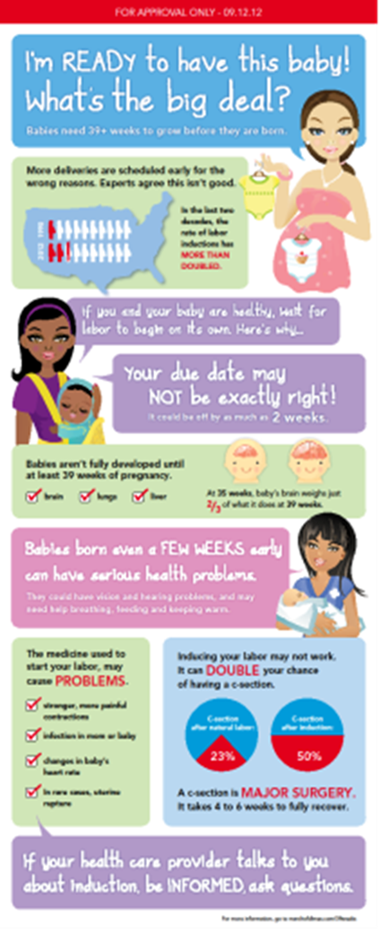

Consumer Education

Slide 11



Slide 12
Resource Access
March of Dimes Fulfillment Center
www.marchofdimes.com/catalog
800.367.6630
Prematurity Prevention Resource Center - MOD resource access for health care professionals
www.prematurityprevention.org
Peristats – National and State Perinatal Data
www.marchofdimes.com/peristats

Slide 13
ASTHO 8X14 Challenge
Association of State & Territorial Health Officials
partnership with the March of Dimes
Goal = 8% reduction in premature birth rate by 2014
Features community programs, professional development and public awareness campaigns

Slide 14
ASTHO Challenge - Kansas
Secretary Moser signed pledge in fall 2012 – official kick-off at annual MOD Perinatal Conference
Kansas Goal = 10.3 (down from current 11.2 rate)
Press Conference – February 2013
Public Awareness Campaign launched in February 2013
(co-branded KDHE/MOD)

Slide 15
ASTHO Challenge
Public Awareness Campaign
Media Launch – February 2013
Press Releases
Billboards – February & June (Wichita, Topeka, Manhattan)
National Television PSA’s
Feature Stories
Virtual Campaign (Social Media, E-blasts, Website Content)
Patient Education Materials

Slide 16
You Can Participate!
Video PSA’s in waiting rooms
Utilize patient education materials
Add campaign content to your website, newsletters, etc.
Leverage your marketing relationships to help us secure free television and print PSA’s.

Slide 17
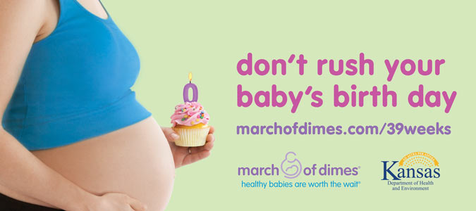
Kansas Billboards

Slide 18

Kansas MOD Initiatives
Kansas Perinatal Quality Collaborative
Community Collaboratives
Birth Disparities Projects
Perinatal Conference

Slide 19
Diane M. Daldrup
Phone: 913.235.9840
Email: ddaldrup@marchofdimes.com

